Slide 1
WCISCC2025 ORNL Challenge: Quantum linear solvers
10 February 2025
OLCF Mentors
Oak Ridge National Laboratory
This research used resources of the Oak Ridge Leadership Computing Facility (OLCF) at the Oak Ridge National Laboratory, which is supported by the Office of Science of the U.S. Department of Energy under Contract No. DE-AC05-00OR22725.

Slide 2
Agenda
Who are we?
Your OLCF Mentors
What is QLSA?
A brief Intro/Catchup
How to use OLCF?
Odo
How to use IQM?
IQM Garnet
The Challenge Problem
&
Demo

Slide 3
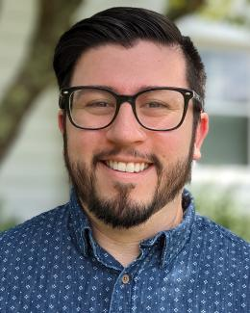
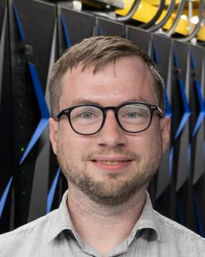
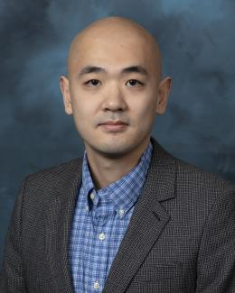
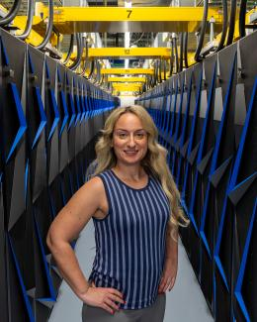
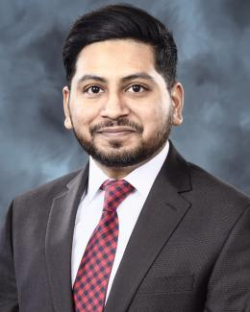
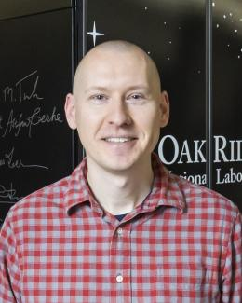
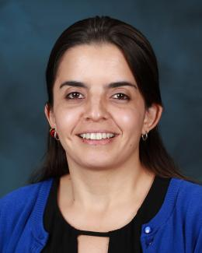
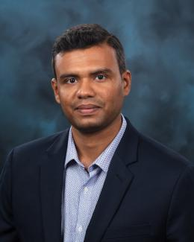
OLCF Mentors
Michael
Sandoval
Dan
Dietz
Chao
Lu
Antigoni
Georgiadou
Kalyan
Gottiparthi
John
Holmen
Verónica
Melesse Vergara
Murali
Gopalakrishnan Meena

Slide 4
Quantum Linear Solvers
A brief Intro/Catchup

Slide 5
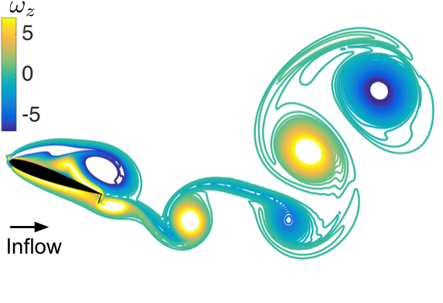






Governing equations are discretized to create a set of algebraic equations & assembled into $Ax=b$
Linear Solver
$$×$$
$$=$$
$$A$$
$$x$$
$$b$$

Slide 6
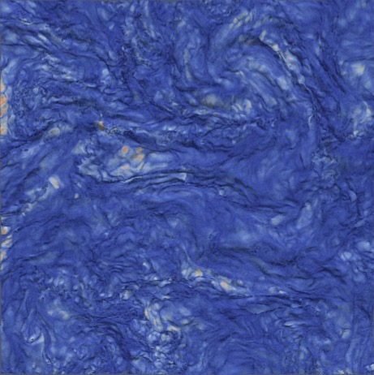
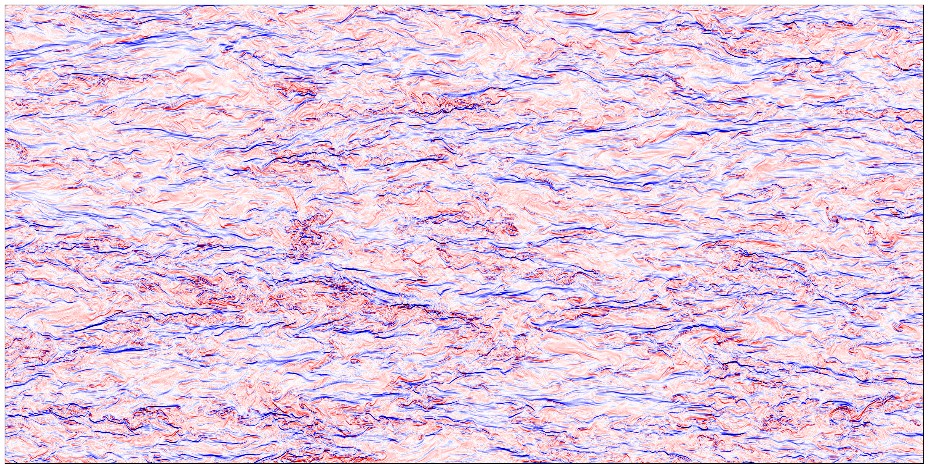
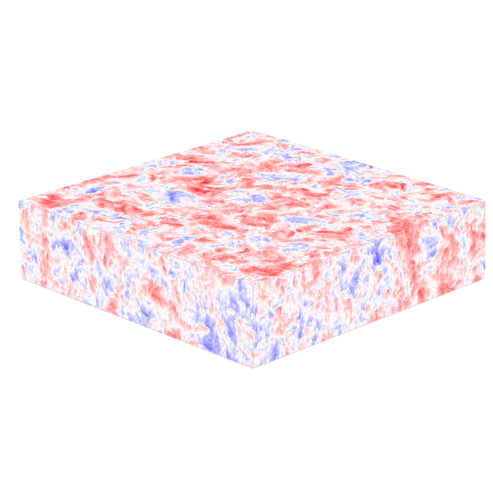
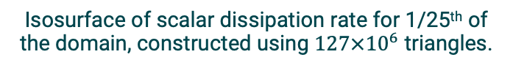
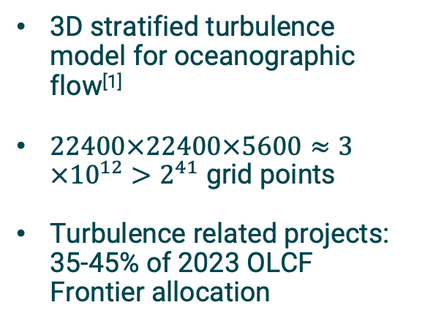
Grid resolution can get prohibitively expensive to simulate for practical fluid flow problems
3D stratified turbulence model for oceanographic flow^{[1]}
$22400×22400×5600≈3×{10}^{12}>2^{41}$ grid points
Turbulence related projects: 35-45% of 2023 OLCF Frontier allocation
Contour plot of the perturbed vertical density gradient for 1/4th of the domain.
Contour plots of the perturbed density after subsampling the domain.
[1] J. J. Riley, et al., J. Turbulence, 2023
Isosurface of scalar dissipation rate for 1/25th of the domain, constructed using $127×{10}^{6}$ triangles.

Slide 7
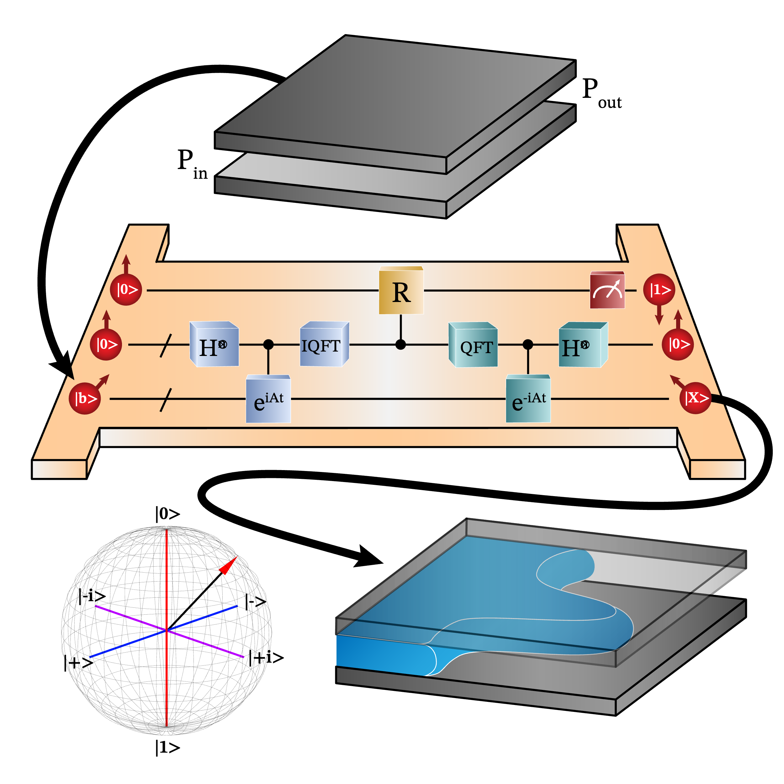
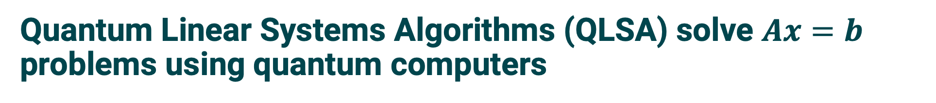
Quantum Linear Systems Algorithms (QLSA) solve $Ax=b$ problems using quantum computers
A canonical QLSA: the Harrow–Hassidim–Lloyd (HHL) algorithm
HHL can be used to solve fluid dynamics problems
Detailed overview: See pre-recorded video
https://github.com/olcf/wciscc2025.git
Notes:
Add Science motivation

Slide 8
OLCF’s Training HPC System
Connecting to Odo

Slide 9
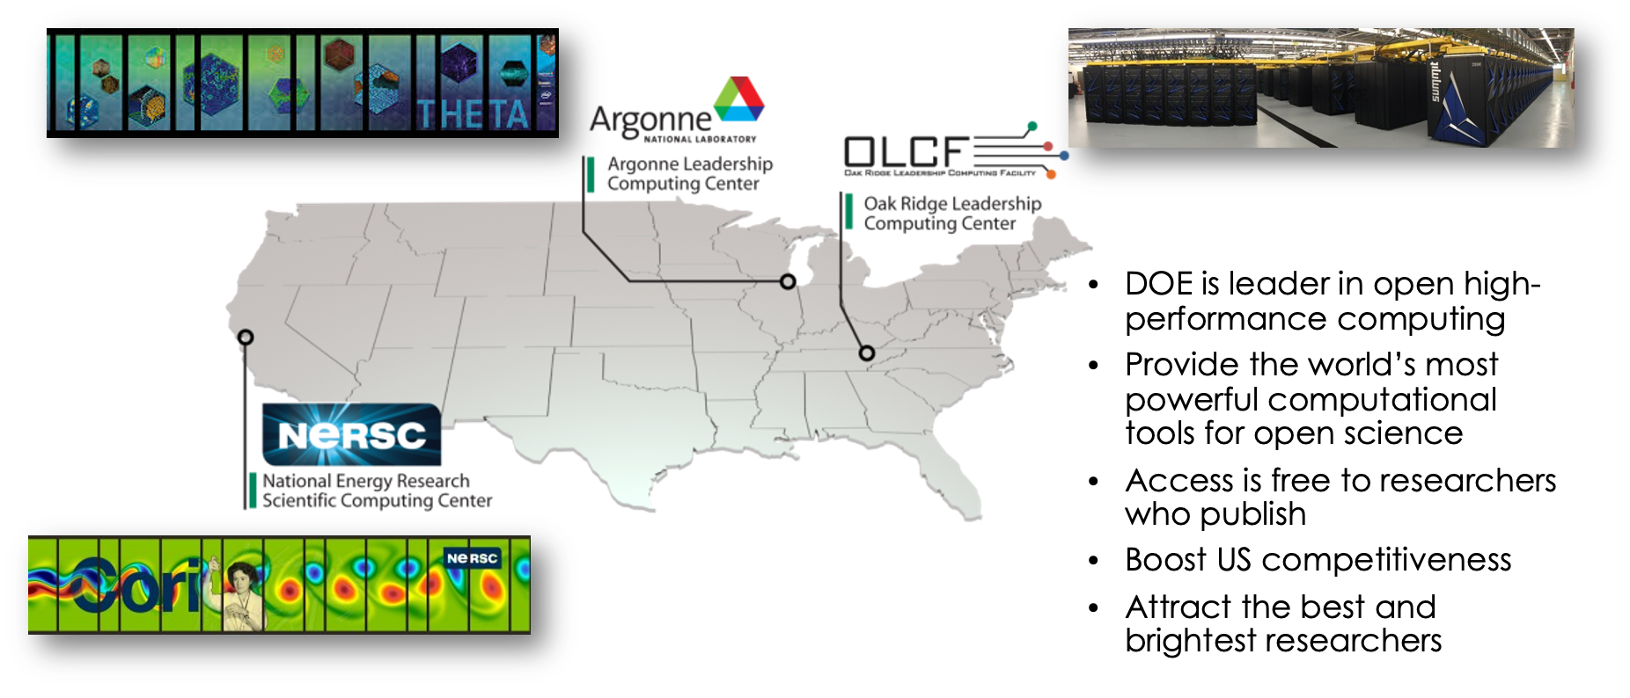
We are one of the DOE’s Office of Science computation user facilities

Slide 10
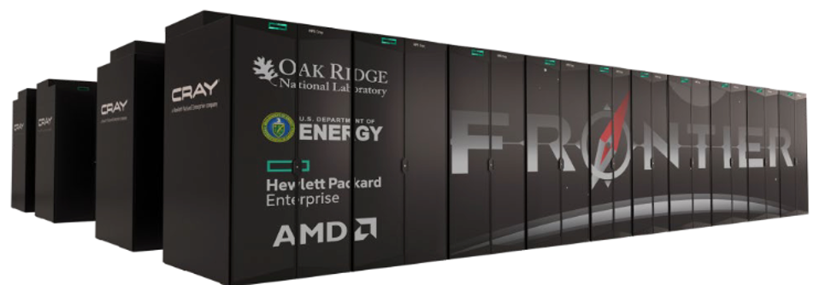
Frontier System Overview
HPE Cray EX Supercomputer architecture
74 cabinets, 128 nodes per cabinet (9408 nodes)
3rd Gen AMD EPYC 64-core CPU
4 AMD Instinct MI250X GPUs
HPE Slingshot interconnect
Peak 1.353 Exaflops on HPL benchmark
Cray, AMD, and GNU software stacks
Orion - 679 PB multi-tier Lustre filesystem
NFS storage (/ccs/home, /ccs/proj)
Odo is 30 Frontier nodes and is our training system. It uses the GPFS filesystem (/gpfs/wolf2) and NFS on the Open Enclave for home areas (/ccsopen/home, /ccsopen/proj).

Slide 11
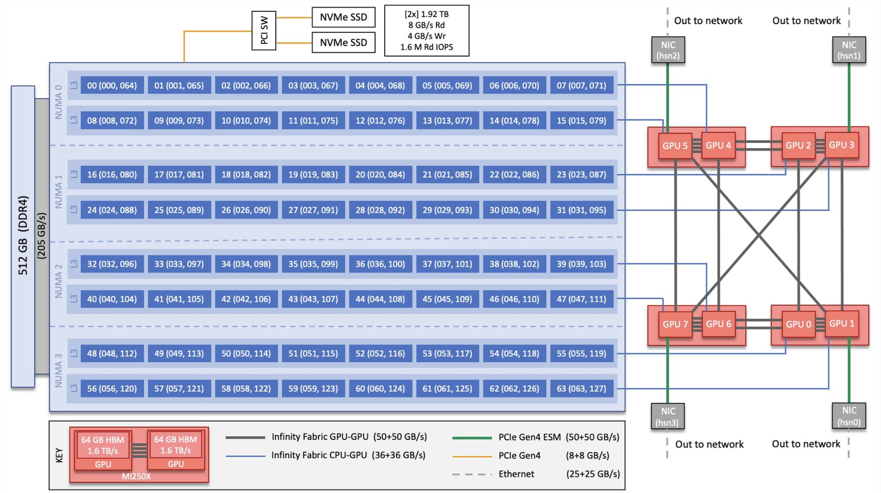
Frontier (Odo) Compute Node Diagram

Slide 12
Your OLCF Account (XCAMS Account)
Your XCAMS username will be in an email with subject line:“OLCF Accounts: You Have Been Added to Project TRN037”
The Accounts team will have sent you an email asking you to setup your password for Odo when you were approved for access the TRN037 account.
Learn more here: https://docs.olcf.ornl.gov/systems/odo_user_guide.html#step-2-set-your-xcams-ucams-password
If you set and then forgot your password you can reset it here: https://user.ornl.gov/Account/ForgottenPassword?reqid=
If you joined the project for this event, any time you see "project ID" you should think "TRN037"
If you still need to apply, you can apply to TRN037 here: https://my.olcf.ornl.gov/account-application-new

Slide 13
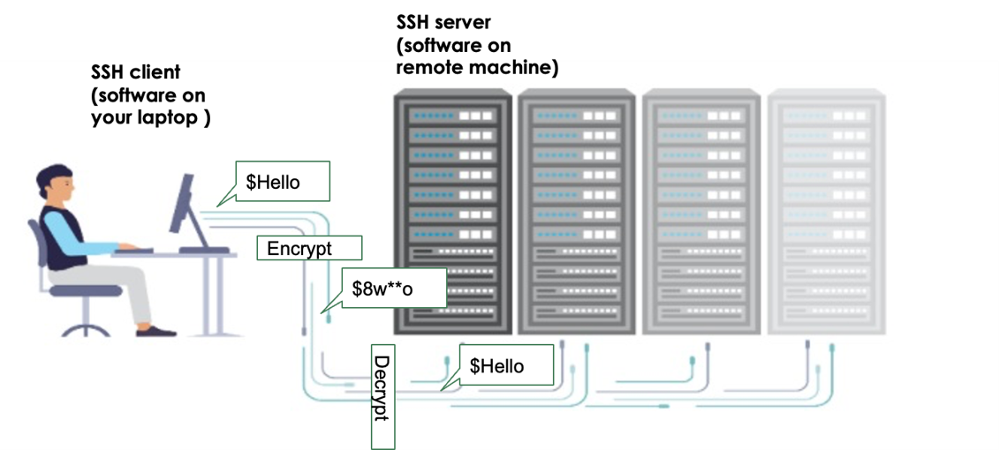
Accessing Remote Clusters
Connect to clusters through "secure shell": SSH

Slide 14
SSH Interfaces
Mac and Linux
From Terminal
Terminal is a command line interface
Comes with ssh software, invoked by “ssh” command.
Windows
Moba Xterm https://mobaxterm.mobatek.net/download-home-edition.htm
Powershell
Putty
Browser-based (ssh terminal)
https://jupyter-open.olcf.ornl.gov/
Login information is the same username/password for Odo
We use this to "hop" to Odo from Jupyter

Slide 15
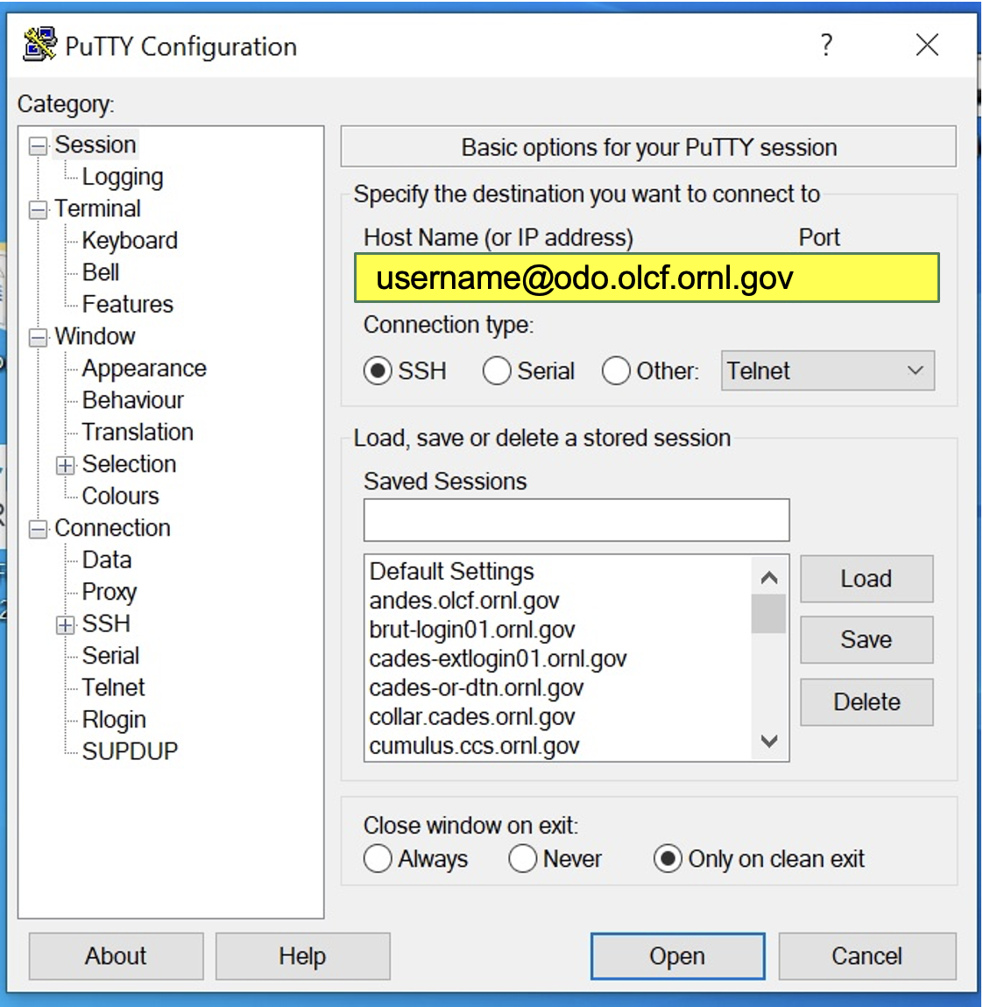
Examples for Login
Option 1: Open Mac Terminal or Windows Powershell and run: ssh username@odo.olcf.ornl.gov
Enter your password when prompted
Option 2: Jupyter Terminal
Open browser
Go to https://jupyter-open.olcf.ornl.gov/
Login with your XCAMS username and password
Choose "Crash Course Training Lab"
Click "Open Terminal"
Run: ssh username@odo.olcf.ornl.gov
Enter your password when prompted
Putty Specific Instructions
Open Putty
Enter: username@odo.olcf.ornl.gov
Click "Open" and enter your password when prompted

Slide 16
QCUP & IQM Resonance
Quantum Hardware Access

Slide 17
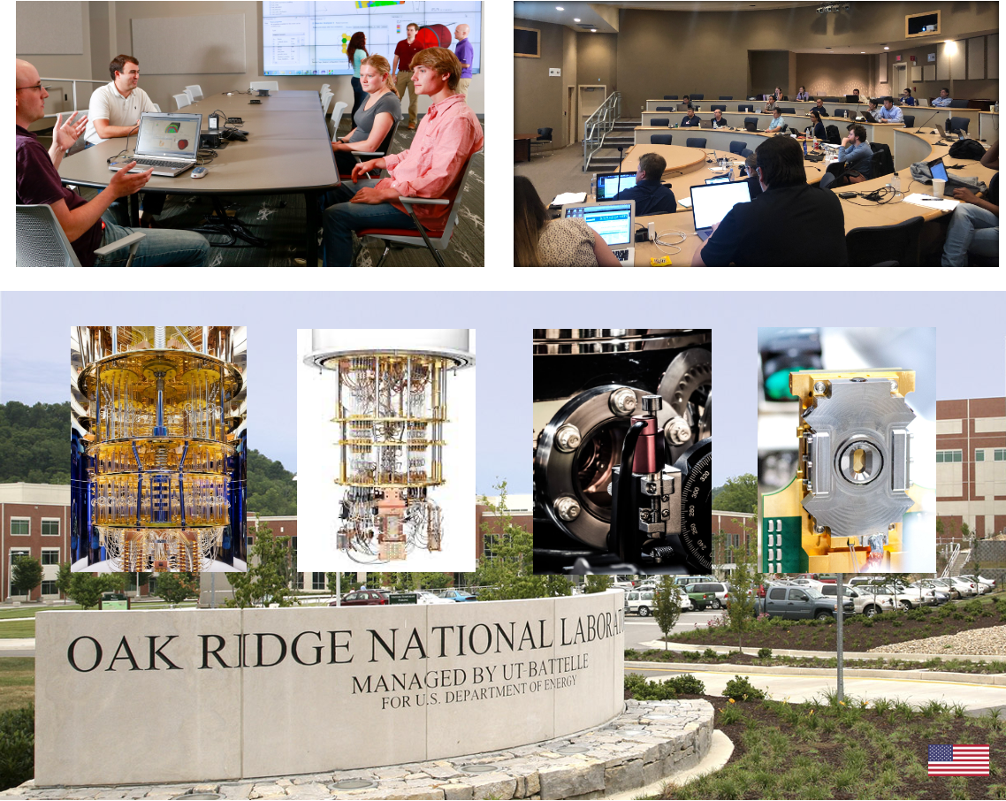
Quantum Computing User Program
Enable Research
Provide a broad spectrum of user access to the best available quantum computing systems
Evaluate Technology
Monitor the breadth and performance of early quantum computing applications
Engage Community
Support growth of the quantum ecosystem by engaging with users, developers, vendors, and providers

Slide 18
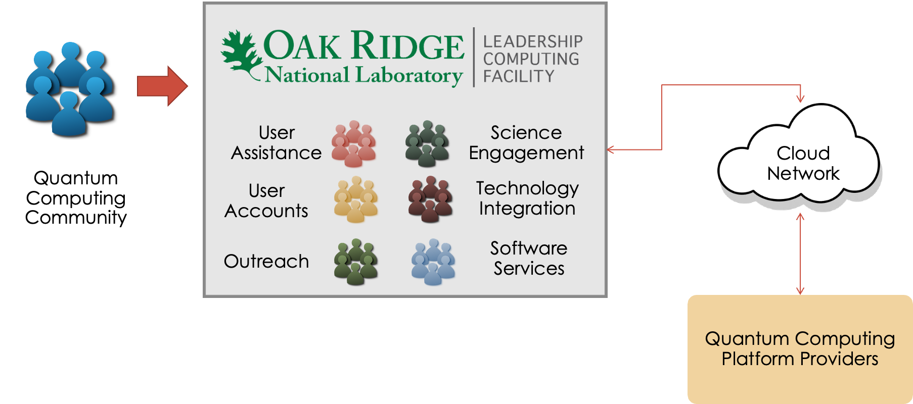
QCUP Operations Model: Cloud Access

Slide 19
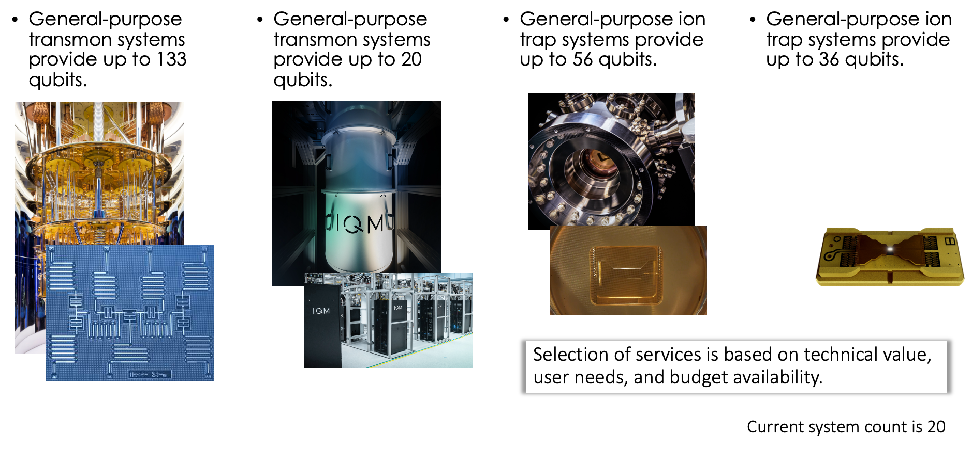
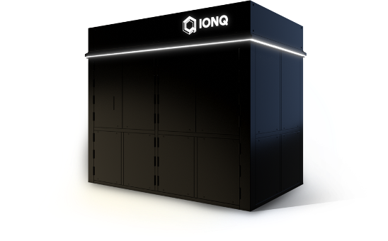
QCUP provides users with access to multiple quantum computing resources.
IBM Quantum
IQM
Quantinuum
IonQ

Slide 20
IQM Resonance
IQM provides access to quantum computing resources through their cloud platform, IQM Resonance.
The 20 qubit Garnet and the 6 qubit Deneb systems.
IQM’s quantum processors are made up of superconducting transmon qubits, utilizing multiple topologies.
User dashboard: https://resonance.meetiqm.com/
OLCF Documentation: https://docs.olcf.ornl.gov/quantum/quantum_systems/iqm.html
We'll be submitting jobs to Garnet via Python from Odo
"Pay-as-you-go" mode
Certain windows where a queue is open
"Timeslot" mode
Reserved for M-F at 10-11 AM (Eastern), 3-4 PM (Eastern)
Should've received an invite from me to create your account (not the same account as Odo!!)

Slide 21
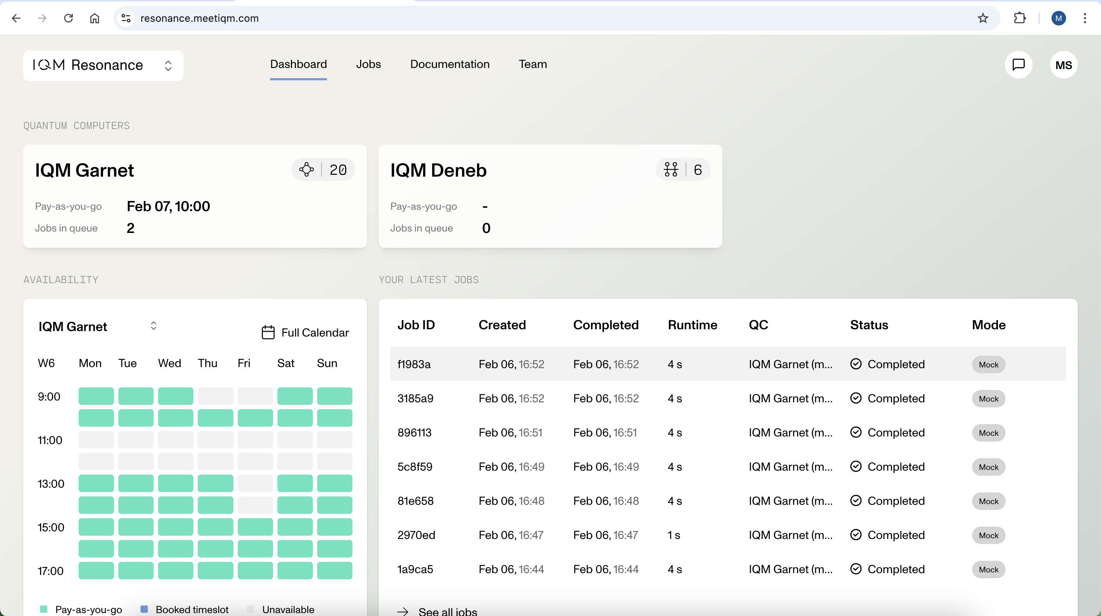
The IQM Resonance Dashboard - I

Slide 22
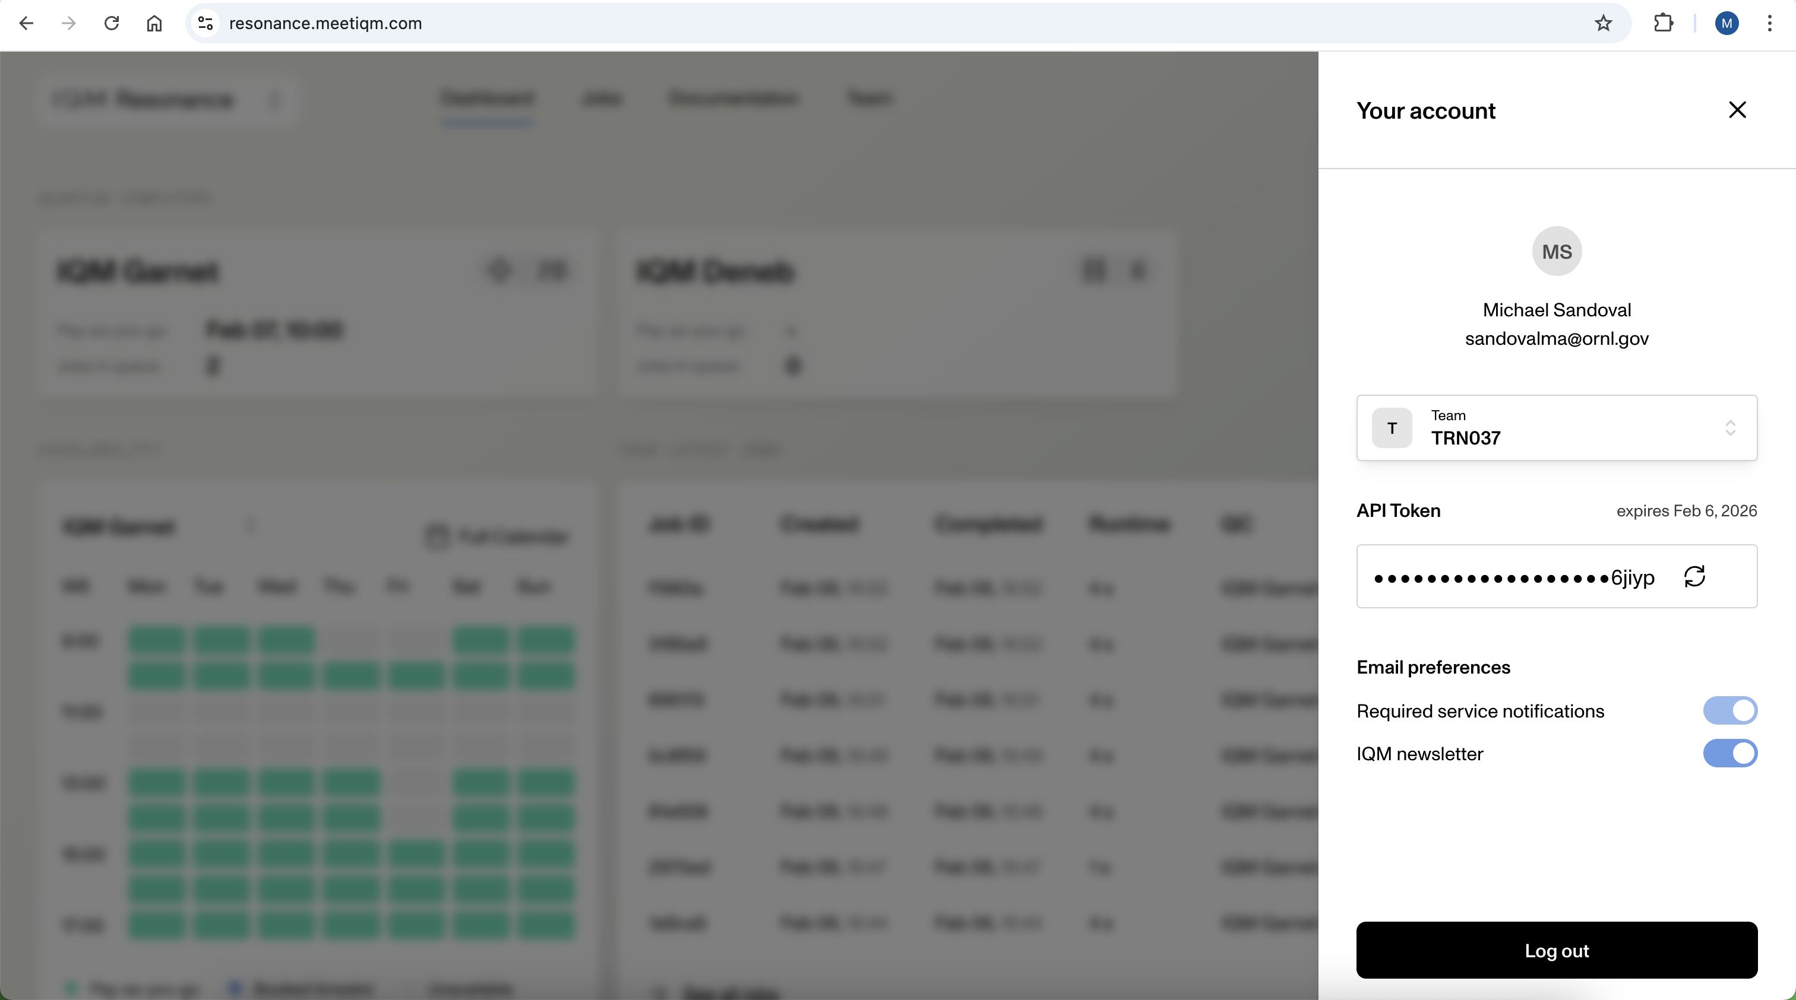
The IQM Resonance Dashboard - II

Slide 23
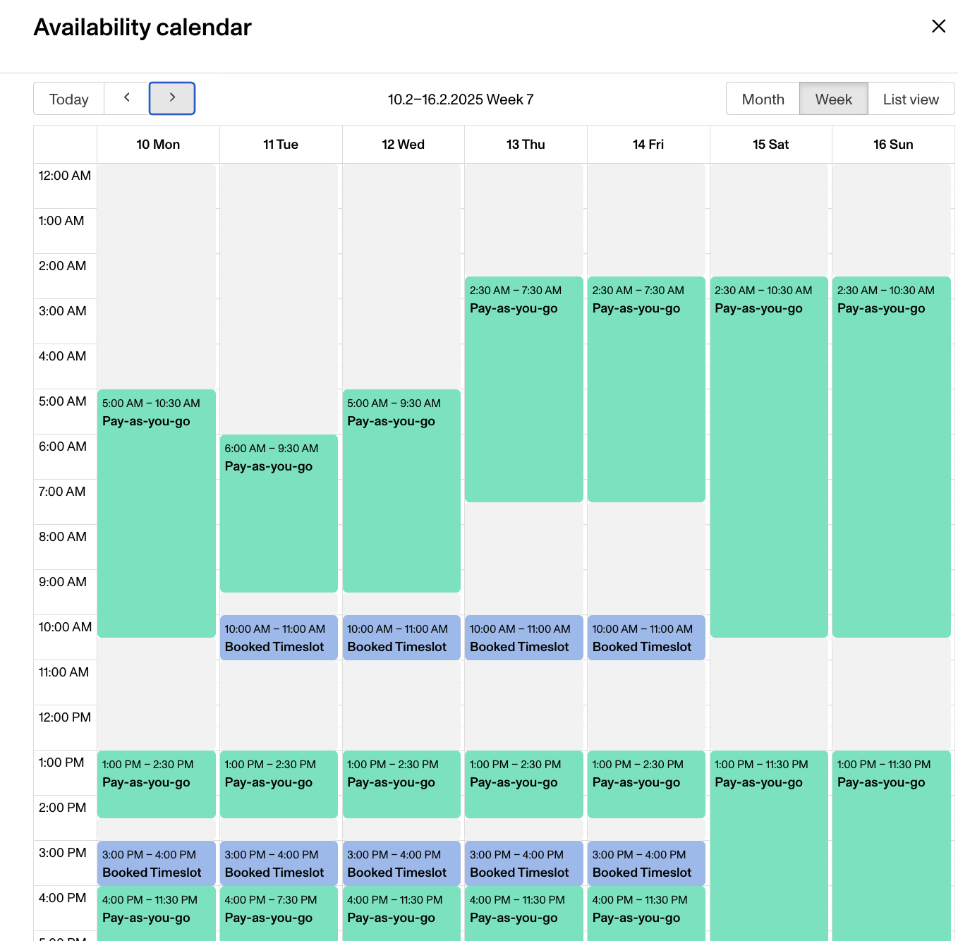
The IQM Resonance Dashboard - III

Slide 24
The ORNL Challenge
QLSA Problems & Demo

Slide 25
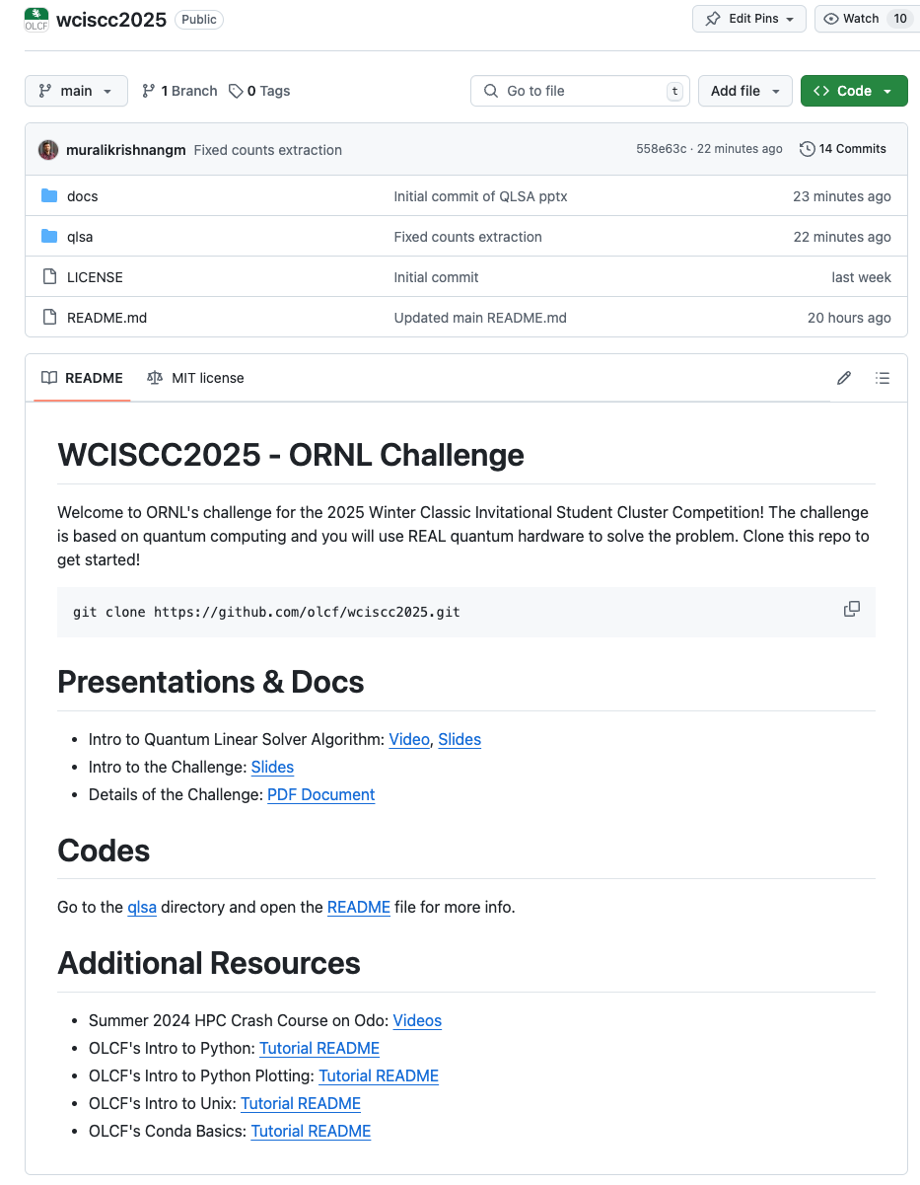
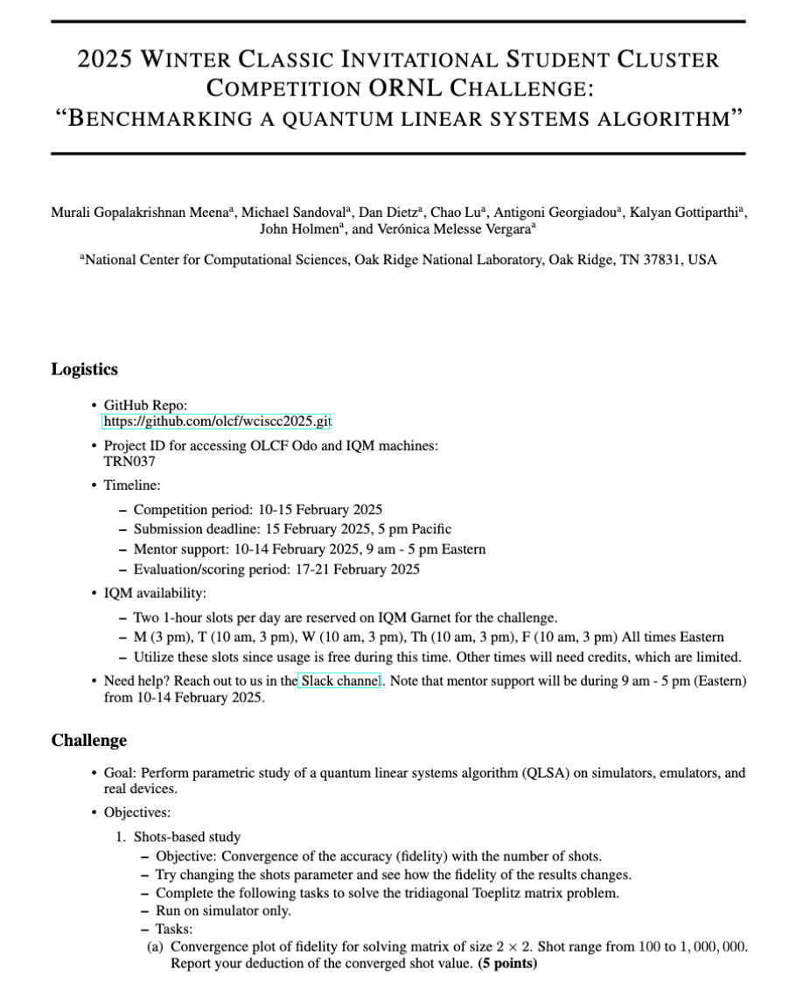
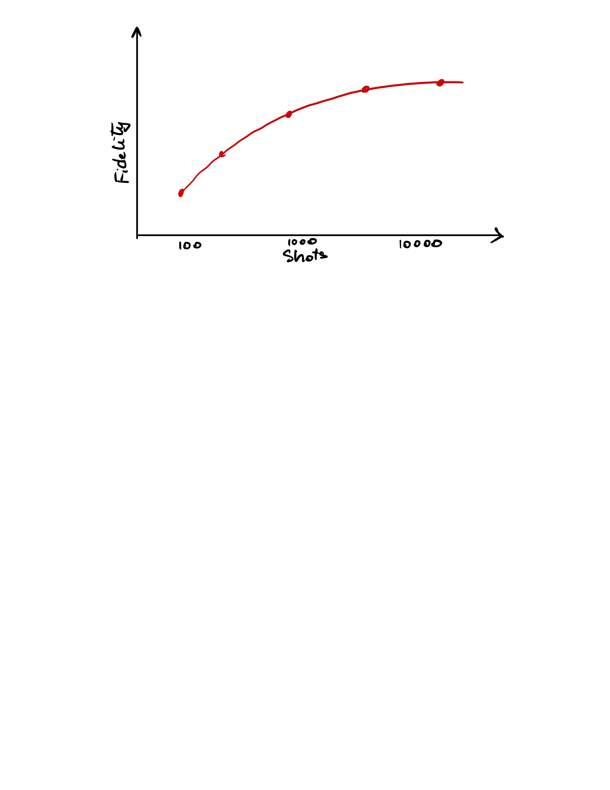
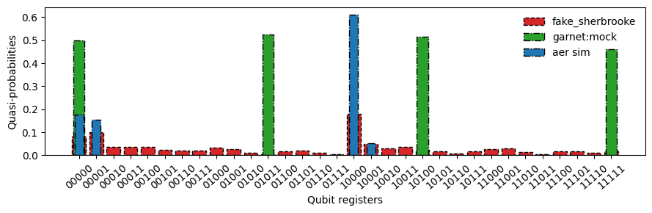
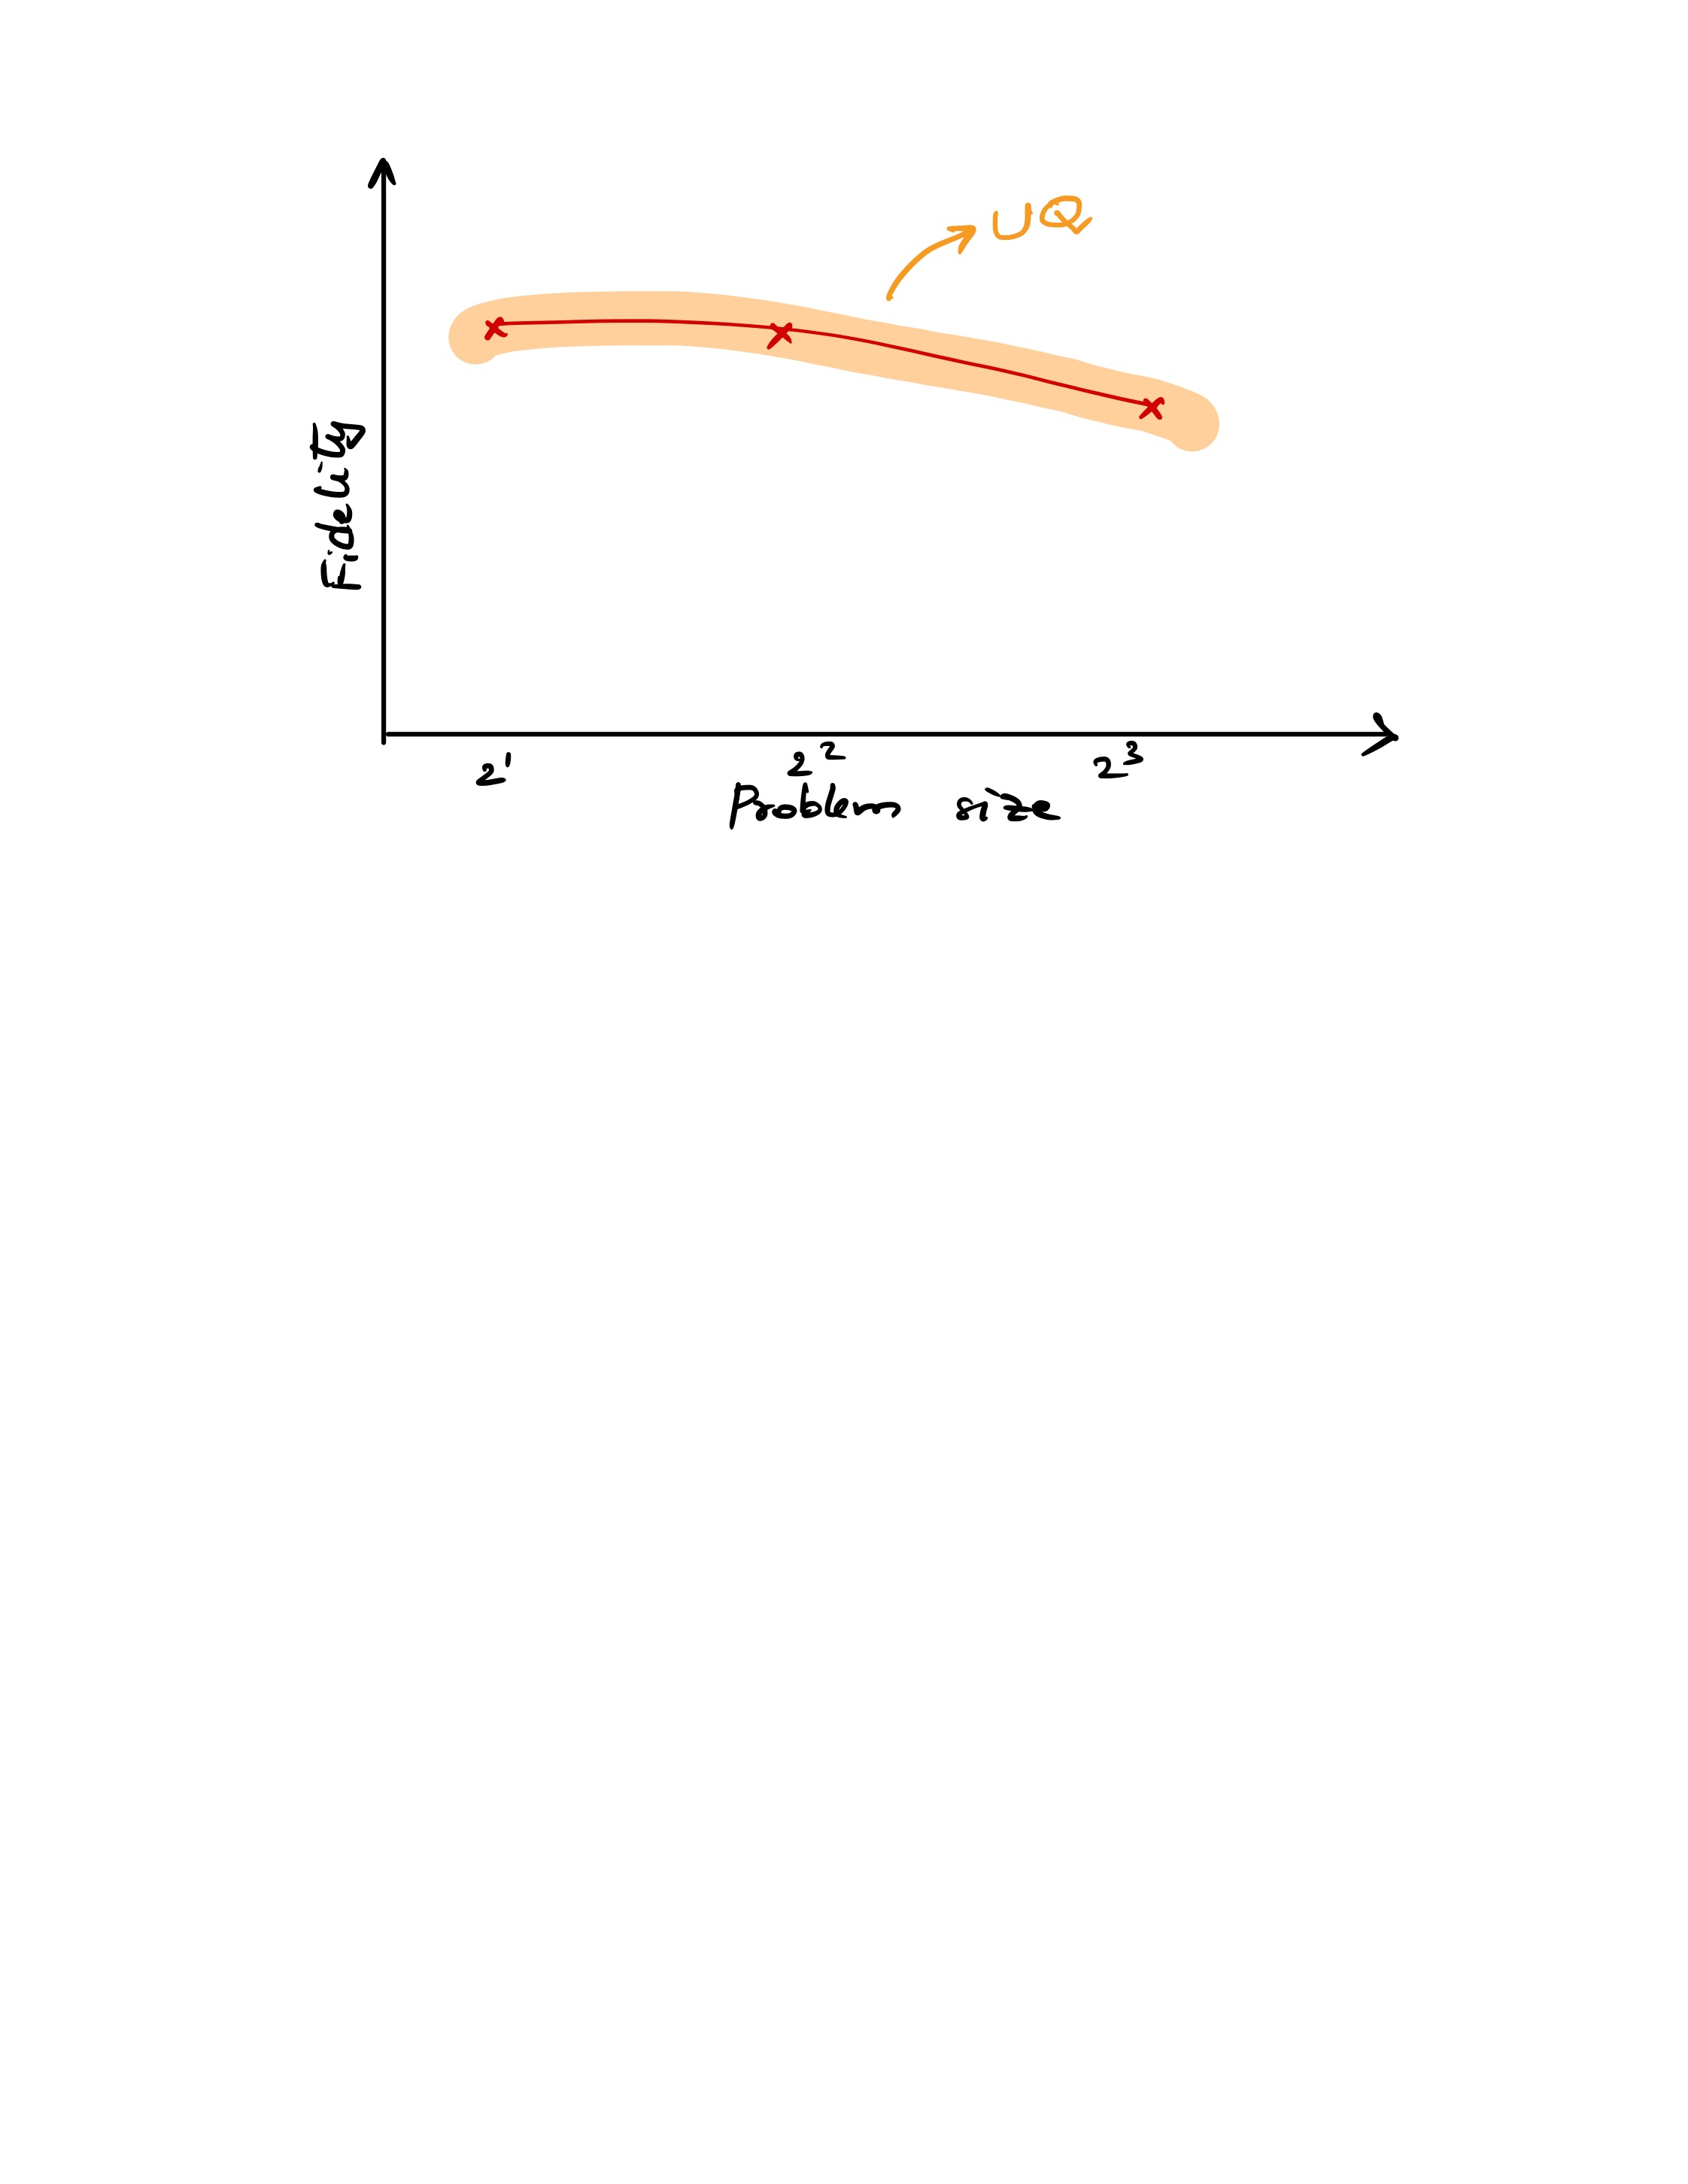
Perform parametric study of HHL on simulators, emulators, and real devices
But first, Demo Time!
https://github.com/olcf/wciscc2025.git
Three Tasks:
Shots-based study
Backend evaluation
Solve the Hele—Shaw flow
Detailed instructions in PDF document – see GitHub Repo

Slide 26
Questions?
https://github.com/olcf/wciscc2025.git

